Slide 1

Chapter 1 Intro to Networks
Some of the materials in these notes are adapted from Computer Networking: A Top Down Approach, 6th edition, by Jim Kurose, Keith Ross

Slide 2
Chapter 1: introduction
our goal:
get “feel” and terminology
more depth, detail later in course
approach:
use Internet as example
overview:
what’s the Internet?
what’s a protocol?
network edge; hosts, access net, physical media
network core: packet/circuit switching, Internet structure
performance: loss, delay, throughput
security
protocol layers, service models
history

Slide 3
Chapter 1: roadmap
1.1 what is the Internet?
1.2 network edge
end systems, access networks, links
1.3 network core
packet switching, circuit switching, network structure
1.4 delay, loss, throughput in networks
1.5 protocol layers, service models
1.6 networks under attack: security
1.7 history

Slide 4




















What’s the Internet: “nuts and bolts” view
PC
millions of connected computing devices:
hosts = end systems
running network apps
mobile network
server
wireless
laptop
global ISP
smartphone
home
network
communication links
fiber, copper, radio, satellite
transmission rate: bandwidth
regional ISP
wireless
links
wired
links
Packet switches: forward packets (chunks of data)
routers and switches
router
institutional
network
Notes:
4
Decompose the internet

Slide 5



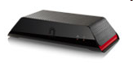

“Fun” internet appliances
Web-enabled toaster +
weather forecaster
IP picture frame
http://www.ceiva.com/
Tweet-a-watt:
monitor energy use
Slingbox: watch,
control cable TV remotely
Internet
refrigerator
Internet phones
Notes:
The following is a short list of applications that could be connected to the Internet and how they would utilize that connection:VCR Camera - it could become a remote web-cam
Microwave Oven - program it remotely to have dinner ready
Smoke/Intruder Alarm - check on your home while out of town
Automobile - allow your mechanic to check out your engine while you are using it
Cellular Communications Device - browse the web using your cell phone
Network computer - lower total cost of computer ownership
Pace maker/heart monitor - see Automobile above

Slide 6
What’s the Internet: “nuts and bolts” view
Internet: “network of networks”
Interconnected ISPs
protocols control sending, receiving of msgs
e.g., TCP, IP, HTTP, Skype, 802.11
Internet standards
RFC: Request for comments
IETF: Internet Engineering Task Force
mobile network
global ISP
home
network
regional ISP
institutional
network

Slide 7
What’s the Internet: a service view
mobile network
Infrastructure that provides services to applications:
Web, VoIP, email, games, e-commerce, social nets, …
provides programming interface to apps
hooks that allow sending and receiving app programs to “connect” to Internet
provides service options, analogous to postal service
global ISP
home
network
regional ISP
institutional
network
Notes:
Comprehend the role of internet

Slide 8

What’s a protocol?
human protocols:
“what’s the time?”
“I have a question”
introductions
… specific msgs sent
… specific actions taken when msgs received, or other events
network protocols:
machines rather than humans
all communication activity in Internet governed by protocols
protocols define format, order of msgs sent and received among network entities, and actions taken on msg transmission, receipt

Slide 9



What’s a protocol?
a human protocol and a computer network protocol:
Hi
TCP connection
request
Hi
TCP connection
response
Got the
time?
Get http://www.awl.com/kurose-ross
2:00
<file>
time
Q: other human protocols?

Slide 10
Chapter 1: roadmap
1.1 what is the Internet?
1.2 network edge
end systems, access networks, links
1.3 network core
packet switching, circuit switching, network structure
1.4 delay, loss, throughput in networks
1.5 protocol layers, service models
1.6 networks under attack: security
1.7 history
Notes:
10

Slide 11

A closer look at network structure:
network edge:
hosts: clients and servers
servers often in data centers
mobile network
global ISP
access networks, physical media: wired, wireless communication links
home
network
regional ISP
network core:
interconnected routers
network of networks
institutional
network
Notes:
This view is to know which components make up the network.
X-box, IP TV, intelligent vehicle
A physical connection from the end system to the first router.
The mesh of packet switches and links

Slide 12


Access networks and physical media
Q: How to connect end systems to edge router?
residential access nets
institutional access networks (school, company)
mobile access networks
keep in mind:
bandwidth (bits per second) of access network
shared or dedicated?
Notes:
B/W of access network varies: Average downstream for DSL = 5Mbps; Cable Modem = 13 Mbps; Fiber To The Home (FTTH) = 20 Mbps
Cable Modem, WiFi are shared; DSL is dedicated. Ethernet shares a switch but each user has dedicated line to the switch.

Slide 13
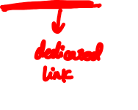
Access net: digital subscriber line (DSL)
central office
telephone
network
DSL
modem
splitter
DSLAM
ISP
voice, data transmitted
at different frequencies over
dedicated line to central office
DSL access
multiplexer
use existing telephone line to central office DSLAM
data over DSL phone line goes to Internet
voice over DSL phone line goes to telephone net
< 2.5 Mbps upstream transmission rate (typically < 1 Mbps)
< 24 Mbps downstream transmission rate (typically < 10 Mbps)

Slide 14
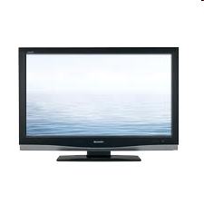



Access net: cable network
cable headend
…
cable
modem
splitter
C
O
N
T
R
O
L
V
I
D
E
O
V
I
D
E
O
V
I
D
E
O
V
I
D
E
O
V
I
D
E
O
V
I
D
E
O
D
A
T
A
D
A
T
A
1
2
3
4
5
6
7
8
9
Channels
frequency division multiplexing: different channels transmitted
in different frequency bands

Slide 15
Access net: cable network
cable headend
…
cable
modem
splitter
CMTS
cable modem
termination system
data, TV transmitted at different
frequencies over shared cable
distribution network
ISP
HFC: hybrid fiber coax
asymmetric: up to 30Mbps downstream transmission rate, 2 Mbps upstream transmission rate
network of cable, fiber attaches homes to ISP router
homes share access network to cable headend
unlike DSL, which has dedicated access to central office
Notes:
Cable modem termination system

Slide 16




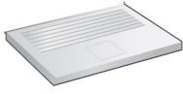
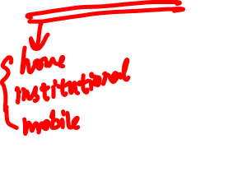
Access net: home network
wireless
devices
to/from headend or central office
often combined
in single box
cable or DSL modem
wireless access
point (54 Mbps)
router, firewall, NAT
wired Ethernet (100 Mbps)
Notes:
Network address translation (NAT) is a method of remapping one IP address space into another by modifying network address information in Internet Protocol (IP) datagram packet headers while they are in transit across a traffic routing device.

Slide 17










Enterprise access networks (Ethernet)
institutional link to
ISP (Internet)
institutional router
Ethernet
switch
institutional mail,
web servers
typically used in companies, universities, etc
10 Mbps, 100Mbps, 1Gbps, 10Gbps transmission rates
today, end systems typically connect into Ethernet switch

Slide 18


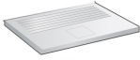





Wireless access networks
shared wireless access network connects end system to router
via base station aka “access point”
wide-area wireless access
provided by telco (cellular) operator, 10’s km
between 1 and 10 Mbps
3G, 4G: LTE
wireless LANs:
within building (100 ft)
802.11b/g (WiFi): 11, 54 Mbps transmission rate
to Internet
to Internet

Slide 19

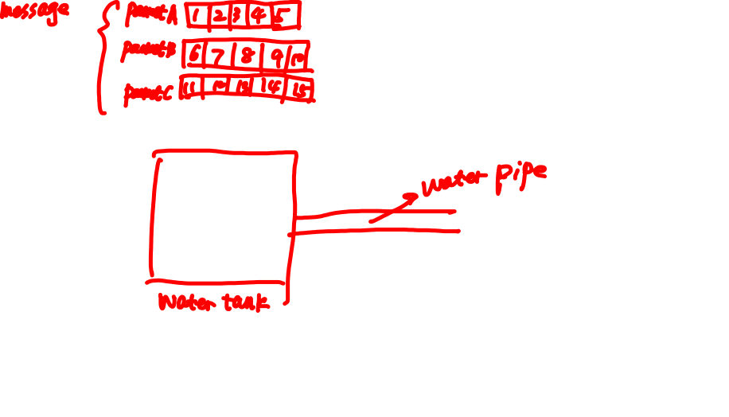

Host: sends packets of data
host sending function:
takes application message
breaks into smaller chunks, known as packets, of length L bits
transmits packet into access network at transmission rate R
link transmission rate, aka link capacity, aka link bandwidth
two packets,
L bits each
2
1
R: link transmission rate
host
packet
transmission
delay
time needed to
transmit L-bit
packet into link
L (bits)
R (bits/sec)
=
=

Slide 20
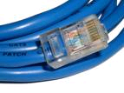
Physical media
bit: propagates between transmitter/receiver pairs
physical link: what lies between transmitter & receiver
guided media:
signals propagate in solid media: copper, fiber, coax
unguided media:
signals propagate freely, e.g., radio
twisted pair (TP)
two insulated copper wires
Category 5: 100 Mbps, 1 Gpbs Ethernet
Category 6: 10Gbps
Notes:
Kicked around like a ball
The waves are guided along a solid/free medium
Atmosphere, or air
Network cable standard

Slide 21


Physical media: coax, fiber
coaxial cable:
two concentric copper conductors
bidirectional
broadband:
multiple channels on cable
HFC
fiber optic cable:
glass fiber carrying light pulses, each pulse a bit
high-speed operation:
high-speed point-to-point transmission (e.g., 10’s-100’s Gpbs transmission rate)
low error rate:
repeaters spaced far apart (up to 100 km)
immune to electromagnetic noise
Notes:
Long-haul vs short-haul
Optical devices in transmitter, receiver, switch
(the optical device in each network card - NIC)

Slide 22
Physical media: radio
signal carried in electromagnetic spectrum
no physical “wire”
bidirectional
propagation environment effects:
reflection
obstruction by objects
interference
radio link types:
terrestrial microwave
e.g. up to 45 Mbps channels
LAN (e.g., WiFi)
11Mbps, 54 Mbps
wide-area (e.g., cellular)
3G cellular: ~ few Mbps
satellite
Kbps to 45Mbps channel (or multiple smaller channels)
270 msec end-end delay
geosynchronous versus low altitude

Slide 23
Chapter 1: roadmap
1.1 what is the Internet?
1.2 network edge
end systems, access networks, links
1.3 network core
packet switching, circuit switching, network structure
1.4 delay, loss, throughput in networks
1.5 protocol layers, service models
1.6 networks under attack: security
1.7 history
Notes:
23

Slide 24







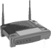

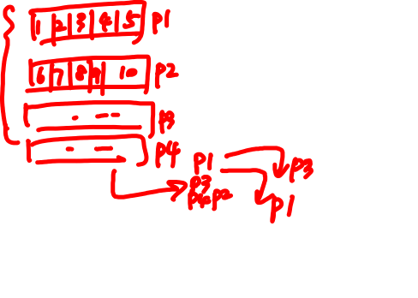
The network core
mesh of interconnected routers
packet-switching: hosts break application-layer messages into packets
forward packets from one router to the next, across links on path from source to destination
each packet transmitted at full link capacity

Slide 25



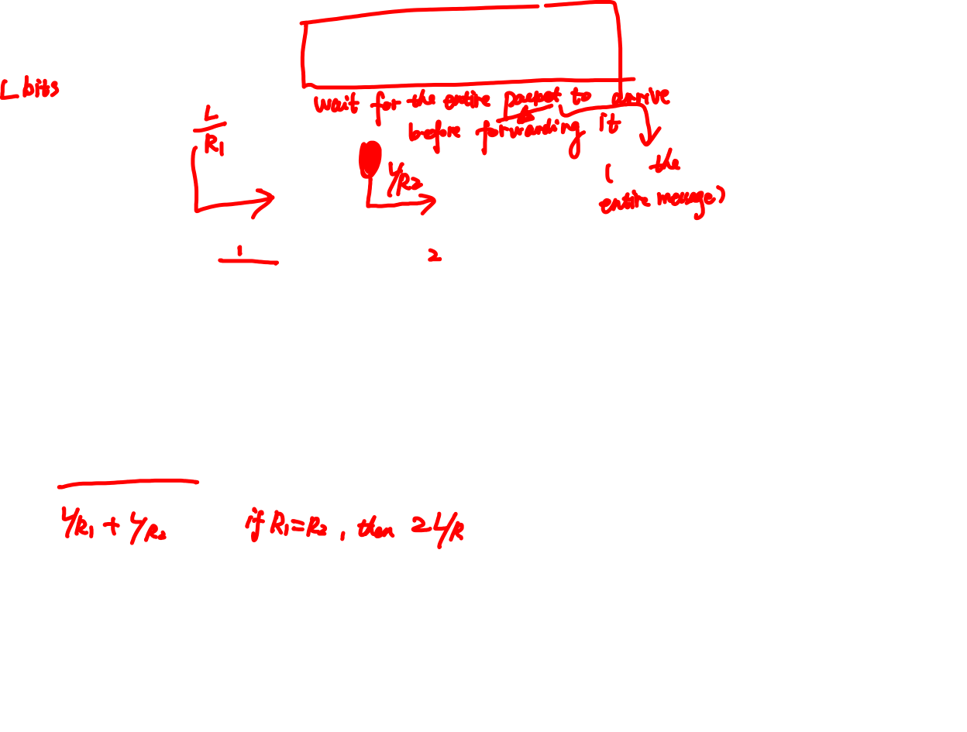
Packet-switching: store-and-forward
L bits
per packet
source
3
2
1
R bps
R bps
destination
takes L/R seconds to transmit (push out) L-bit packet into link at R bps
store and forward: entire packet must arrive at router before it can be transmitted on next link
one-hop numerical example:
L = 7.5 Mbits
R = 1.5 Mbps
one-hop transmission delay = 5 sec
end-end delay = 2L/R (assuming zero propagation delay)
more on delay shortly …
Notes:
Delay: time that elapses from the source to the destination

Slide 27
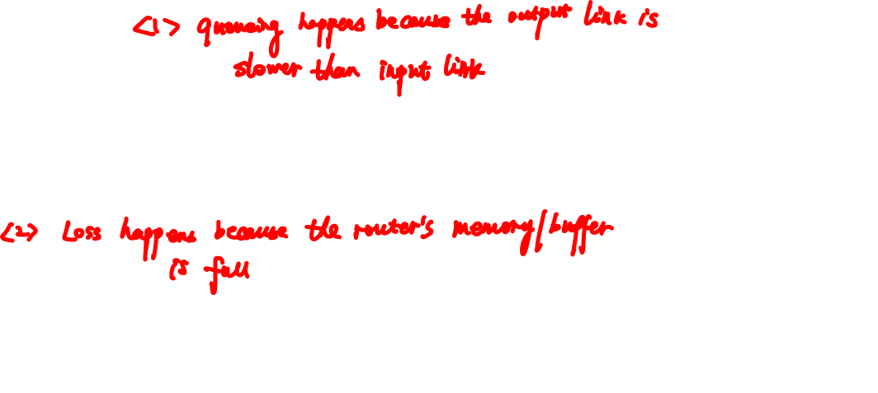
Packet Switching: queueing delay, loss
R = 100 Mb/s
C
A
D
R = 1.5 Mb/s
B
E
queue of packets
waiting for output link
queuing and loss:
If arrival rate (in bits) to link exceeds transmission rate of link for a period of time:
packets will queue, wait to be transmitted on link
packets can be dropped (lost) if memory (buffer) fills up

Slide 28
Two key network-core functions
routing: determines source-destination route taken by packets
routing algorithms
forwarding: move packets from router’s input to appropriate router output
routing algorithm
local forwarding table
header value
output link
0100
0101
0111
1001
3
2
2
1
1
3
2
0111
dest address in arriving
packet’s header

Slide 29

Alternative core: circuit switching
end-end resources allocated to, reserved for “call” between source & dest:
In diagram, each link has four circuits.
call gets 2nd circuit in top link and 1st circuit in right link.
dedicated resources: no sharing
circuit-like (guaranteed) performance
circuit segment idle if not used by call (no sharing)
Commonly used in traditional telephone networks

Slide 30
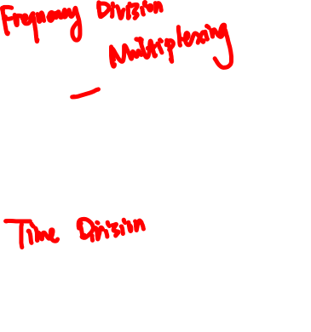
Circuit switching: FDM versus TDM
Example:
FDM
4 users
frequency
time
TDM
frequency
time
Notes:
Two simple multiple access control techniques.
Each mobile’s share of the bandwidth is divided into portions for the uplink and the downlink. Also, possibly, out of band signaling.
As we will see, used in AMPS (Advanced Mobile Phone Servie), GSM (Groupe Special Mobile), IS-54/136
FDM gets a fraction of the bandwidth. And, TDM gets all of the bandwidth periodically.

Slide 31
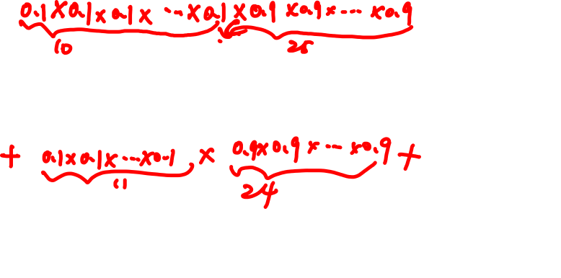
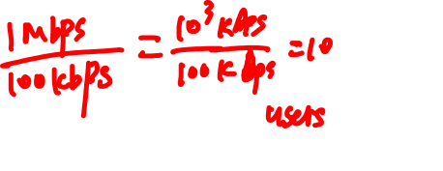
Packet switching versus circuit switching
packet switching allows more users to use network!
example:
1 Mb/s link
each user:
100 kb/s when “active”
active 10% of time
circuit-switching:
10 users
packet switching:
with 35 users, probability > 10 active at same time is less than .0004 *
N
users
…..
1 Mbps link
Q: how did we get value 0.0004?
Q: what happens if > 35 users ?
* Check out the online interactive exercises for more examples
Notes:
With ckt swch, 100kbps must be allocated for each user at all times. Only 10 users supported.
With pkt swch, it is demand driven, so the user idle periods can be used by someone else
The answers can be proved using a combination of binomial distribution and central limit theorem. We will accept answer as is.
If there are > 35 users there will likely be queueing delays

Slide 32
Packet switching versus circuit switching
is packet switching a “slam dunk winner?”
great for bursty data
resource sharing
simpler, no call setup
excessive congestion possible: packet delay and loss
protocols needed for reliable data transfer, congestion control
Q: How to provide circuit-like behavior?
bandwidth guarantees needed for audio/video apps
still an unsolved problem (chapter 7)
Q: human analogies of reserved resources (circuit switching) versus on-demand allocation (packet-switching)?
Notes:
Human analogies: ckt swch: rsvd resource. Is train line on road system.
Pkt swch is road system with no lights
Circuit switch vs. packet switch
Frame relay, virtual circuit

Slide 33
Internet structure: network of networks
End systems connect to Internet via access ISPs (Internet Service Providers)
Residential, company and university ISPs
Access ISPs in turn must be interconnected.
So that any two hosts can send packets to each other
Resulting network of networks is very complex
Evolution was driven by economics and national policies
Let’s take a stepwise approach to describe current Internet structure
Notes:
Evolution driven by economics and politics rather than performance.

Slide 34
Internet structure: network of networks
Question: given millions of access ISPs, how to connect them together?
…
…
access
net
access
net
access
net
access
net
access
net
access
net
access
net
…
…
access
net
access
net
access
net
access
net
access
net
access
net
…
access
net
access
net
…
access
net

Slide 35

Internet structure: network of networks
Option: connect each access ISP to every other access ISP?
…
…
access
net
access
net
access
net
access
net
access
net
…
…
access
net
access
net
…
connecting each access ISP to each other directly doesn’t scale: O(N²) connections.
…
…
access
net
access
net
…
access
net
access
net
access
net
…
access
net
…
access
net
access
net
…
access
net

Slide 36
Internet structure: network of networks
Option: connect each access ISP to a global transit ISP? Customer and provider ISPs have economic agreement.
…
…
access
net
access
net
access
net
access
net
access
net
access
net
access
net
…
…
global ISP
access
net
access
net
access
net
access
net
access
net
access
net
…
access
net
access
net
…
access
net
Notes:
But who will build the single global ISP? Not practical or convenient. Thus we have multiple global ISPs (Tier 1) which typically span the globe. Regional (Tier 2) ISPs connect to them. Access (Tier 3) ISPs then connect to Regional ISPs

Slide 37
Internet structure: network of networks
But if one global ISP is viable business, there will be competitors ….
…
…
access
net
access
net
access
net
access
net
access
net
access
net
access
net
ISP A
…
…
access
net
ISP B
access
net
ISP C
access
net
access
net
access
net
access
net
…
access
net
access
net
…
access
net

Slide 38
Internet structure: network of networks
But if one global ISP is viable business, there will be competitors …. which must be interconnected
Internet exchange point
…
…
access
net
access
net
access
net
access
net
access
net
IXP
access
net
access
net
ISP A
…
…
IXP
access
net
access
net
ISP B
ISP C
access
net
access
net
peering link
access
net
access
net
…
access
net
access
net
…
access
net
Notes:
Peers allow traffic to pass thru each other instead of through upstream intermediaries.
IXP (Internet Exchange Point) is a third party entity consisting of routers which allow multiple ISP to peer together instead of using a direct link.

Slide 39
Internet structure: network of networks
… and regional networks may arise to connect access nets to ISPS
…
…
access
net
access
net
access
net
access
net
access
net
IXP
access
net
access
net
ISP A
…
…
IXP
access
net
access
net
ISP B
ISP C
access
net
access
net
access
net
regional net
access
net
…
access
net
access
net
…
access
net

Slide 40
Internet structure: network of networks
… and content provider networks (e.g., Google, Microsoft, Akamai ) may run their own network, to bring services, content close to end users
…
…
access
net
access
net
access
net
access
net
access
net
IXP
access
net
access
net
ISP A
…
…
Content provider network
IXP
access
net
access
net
ISP B
ISP B
access
net
access
net
access
net
regional net
access
net
…
access
net
access
net
…
access
net
Notes:
Regional Net is Regional ISP.
Content Provider Net (Content Distribution Net) is at a higher level. Google is an example. They have their own world wide private TCP IP network of servers providing content.

Slide 41
Internet structure: network of networks
Tier 1 ISP
Tier 1 ISP
Google
IXP
IXP
IXP
Regional ISP
Regional ISP
access
ISP
access
ISP
access
ISP
access
ISP
access
ISP
access
ISP
access
ISP
access
ISP
at center: small # of well-connected large networks
“tier-1” commercial ISPs (e.g., Level 3, Sprint, AT&T, NTT), national & international coverage
content provider network (e.g, Google): private network that connects it data centers to Internet, often bypassing tier-1, regional ISPs

Slide 42
Tier-1 ISP: e.g., Sprint
POP: point-of-presence
to/from backbone
peering
…
…
…
…
…
to/from customers
Notes:
A PoP is simply a group of one or more routers, at the same location, in the provider’s network where customer ISPs can connect into the provider ISP.

Slide 43
Chapter 1: roadmap
1.1 what is the Internet?
1.2 network edge
end systems, access networks, links
1.3 network core
packet switching, circuit switching, network structure
1.4 delay, loss, throughput in networks
1.5 protocol layers, service models
1.6 networks under attack: security
1.7 history
Notes:
43

Slide 44
How do loss and delay occur?
packets queue in router buffers
packet arrival rate to link (temporarily) exceeds output link capacity
packets queue, wait for turn
packet being transmitted (delay)
A
B
packets queueing (delay)
free (available) buffers: arriving packets
dropped (loss) if no free buffers

Slide 45

Four sources of packet delay
transmission
A
propagation
B
nodal
processing
queueing
d_{nodal} = d_{proc} + d_{queue} + d_{trans} + d_{prop}
d_{proc}: nodal processing
check bit errors
determine output link
typically < msec
d_{queue}: queueing delay
time waiting at output link for transmission
depends on congestion level of router

Slide 46

Four sources of packet delay
transmission
A
propagation
B
nodal
processing
queueing
d_{nodal} = d_{proc} + d_{queue} + d_{trans} + d_{prop}
d_{trans}: transmission delay:
L: packet length (bits)
R: link bandwidth (bps)
d_{trans} = L/R
d_{prop}: propagation delay:
d: length of physical link
s: propagation speed in medium (~2x10⁸ m/sec)
d_{prop} = d/s
d_{trans} and d_{prop}
very different
* Check out the Java applet for an interactive animation on trans vs. prop delay
Notes:
46

Slide 47
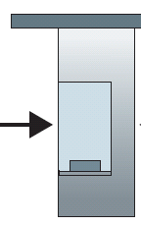
Caravan analogy
100 km
100 km
ten-car
caravan
toll
booth
toll
booth
cars “propagate” at 100 km/hr
toll booth takes 12 sec to service car (bit transmission time)
car~bit; caravan ~ packet
Q: How long until caravan is lined up before 2nd toll booth?
time to “push” entire caravan through toll booth onto highway = 12*10 = 120 sec
time for last car to propagate from 1st to 2nd toll both: 100km/(100km/hr)= 1 hr
A: 62 minutes

Slide 48


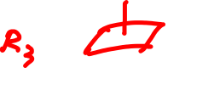
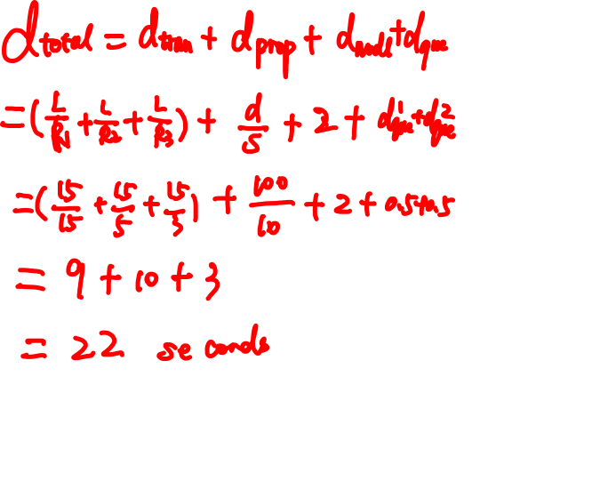





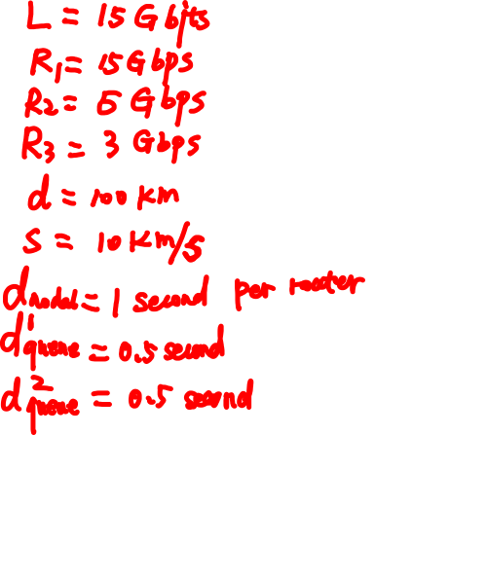
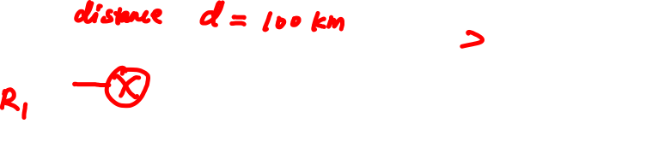

Slide 49
Caravan analogy (more)
100 km
100 km
ten-car
caravan
toll
booth
toll
booth
suppose cars now “propagate” at 1000 km/hr
and suppose toll booth now takes one min to service a car
Q: Will cars arrive to 2nd booth before all cars serviced at first booth?
A: Yes! after 7 min, 1st car arrives at second booth; three cars still at 1st booth.

Slide 50
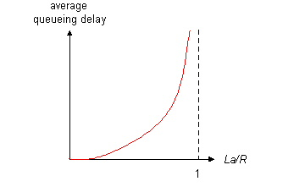

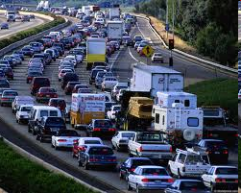

Queueing delay (revisited)
R: link bandwidth (bps)
L: packet length (bits)
a: average packet arrival rate
average queueing delay
traffic intensity
= La/R
La/R ~ 0: avg. queueing delay small
La/R -> 1: avg. queueing delay large
La/R > 1: more “work” arriving
than can be serviced, average delay infinite!
La/R ~ 0
* Check out the Java applet for an interactive animation on queuing and loss
La/R -> 1

Slide 51
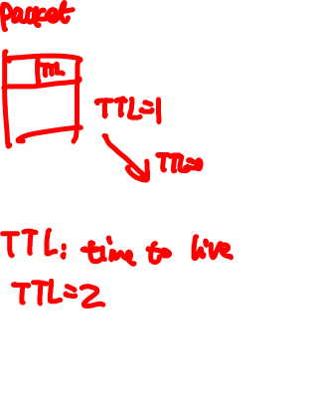
“Real” Internet delays and routes
what do “real” Internet delay & loss look like?
traceroute program: provides delay measurement from source to router along end-end Internet path towards destination. For all i:
sends three packets that will reach router i on path towards destination
router i will return packets to sender
sender times interval between transmission and reply.
3 probes
3 probes
3 probes
Notes:
Windows: tracert

Slide 52
“Real” Internet delays, routes
traceroute: gaia.cs.umass.edu to www.eurecom.fr
3 delay measurements from
gaia.cs.umass.edu to cs-gw.cs.umass.edu
1 cs-gw (128.119.240.254) 1 ms 1 ms 2 ms
2 border1-rt-fa5-1-0.gw.umass.edu (128.119.3.145) 1 ms 1 ms 2 ms
3 cht-vbns.gw.umass.edu (128.119.3.130) 6 ms 5 ms 5 ms
4 jn1-at1-0-0-19.wor.vbns.net (204.147.132.129) 16 ms 11 ms 13 ms
5 jn1-so7-0-0-0.wae.vbns.net (204.147.136.136) 21 ms 18 ms 18 ms
6 abilene-vbns.abilene.ucaid.edu (198.32.11.9) 22 ms 18 ms 22 ms
7 nycm-wash.abilene.ucaid.edu (198.32.8.46) 22 ms 22 ms 22 ms
8 62.40.103.253 (62.40.103.253) 104 ms 109 ms 106 ms
9 de2-1.de1.de.geant.net (62.40.96.129) 109 ms 102 ms 104 ms
10 de.fr1.fr.geant.net (62.40.96.50) 113 ms 121 ms 114 ms
11 renater-gw.fr1.fr.geant.net (62.40.103.54) 112 ms 114 ms 112 ms
12 nio-n2.cssi.renater.fr (193.51.206.13) 111 ms 114 ms 116 ms
13 nice.cssi.renater.fr (195.220.98.102) 123 ms 125 ms 124 ms
14 r3t2-nice.cssi.renater.fr (195.220.98.110) 126 ms 126 ms 124 ms
15 eurecom-valbonne.r3t2.ft.net (193.48.50.54) 135 ms 128 ms 133 ms
16 194.214.211.25 (194.214.211.25) 126 ms 128 ms 126 ms
17 * * *
18 * * *
19 fantasia.eurecom.fr (193.55.113.142) 132 ms 128 ms 136 ms
trans-oceanic
link
* means no response (probe lost, router not replying)
* Do some traceroutes from exotic countries at www.traceroute.org

Slide 53

Packet loss
queue (aka buffer) preceding link in buffer has finite capacity
packet arriving to full queue dropped (aka lost)
lost packet may be retransmitted by previous node, by source end system, or not at all
buffer
(waiting area)
A
packet being transmitted
B
packet arriving to
full buffer is lost
* Check out the Java applet for an interactive animation on queuing and loss

Slide 54

Throughput
throughput: rate (bits/time unit) at which bits transferred between sender/receiver
instantaneous: rate at given point in time
average: rate over longer period of time
server, with
file of F bits
to send to client
link capacity
R_{s} bits/sec
link capacity
R_{c} bits/sec
server sends bits
(fluid) into pipe
pipe that can carry
fluid at rate
R_{s} bits/sec)
pipe that can carry
fluid at rate
R_{c} bits/sec)

Slide 55
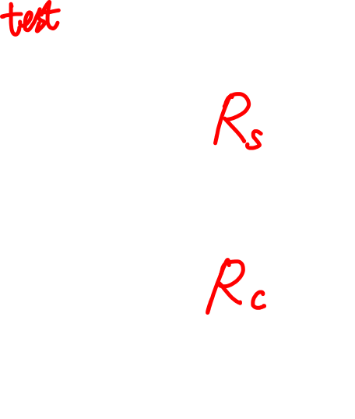
Throughput (more)
R_{s} < R_{c} What is average end-end throughput?
R_{s} bits/sec
R_{c} bits/sec
R_{s} > R_{c} What is average end-end throughput?
R_{s} bits/sec
R_{c} bits/sec
bottleneck link
link on end-end path that constrains end-end throughput

Slide 56
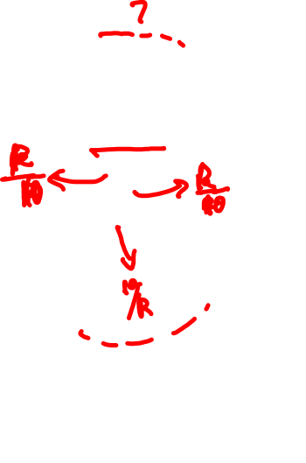

Throughput: Internet scenario
per-connection end-end throughput: min(R_{c},R_{s},R/10)
in practice: R_{c} or R_{s} is often bottleneck
R_{s}
R_{s}
R_{s}
R
R_{c}
R_{c}
R_{c}
10 connections (fairly) share backbone bottleneck link R bits/sec

Slide 57
Chapter 1: roadmap
1.1 what is the Internet?
1.2 network edge
end systems, access networks, links
1.3 network core
packet switching, circuit switching, network structure
1.4 delay, loss, throughput in networks
1.5 protocol layers, service models
1.6 networks under attack: security
1.7 history
Notes:
57

Slide 58
Protocol “layers”
Networks are complex,
with many “pieces”:
hosts
routers
links of various media
applications
protocols
hardware, software
Question:
is there any hope of organizing structure of network?
…. or at least our discussion of networks?

Slide 59


The Postal Analogy
How would the OSI (Open Systems Interconnection) compare to the regular Post Office
Application
A- Write a 20 page letter to a foreign country.
P- Translate the letter so the receiver can read it.
S- Insure the intended recipient can receive letter.
T- Separate and number pages. Like registered mail, tracks delivery and requests another package if one is “lost” or “damaged” in the mail.
N- Postal Center sorting letters by zip code to route them closer to destination.
D- Local Post Office determining which vehicles to deliver letters.
P- Physical Trucks, Planes, Rail, autos, etc which carry letter between stations.
Presentation
Session
Transport
Network
Data-Link
Physical

Slide 60


Remembering the 7 Layers
7 - Application All
6 - Presentation People
5 - Session Seem
4 - Transport To
3 - Network Need
2 - Data Link Data
1 - Physical Processing

Slide 61
Organization of air travel
ticket (purchase)
baggage (check)
gates (load)
runway takeoff
airplane routing
ticket (complain)
baggage (claim)
gates (unload)
runway landing
airplane routing
airplane routing
a series of steps

Slide 62
Layering of airline functionality
ticket (purchase)
baggage (check)
gates (load)
runway (takeoff)
airplane routing
ticket (complain)
baggage (claim
gates (unload)
runway (land)
airplane routing
ticket
baggage
gate
takeoff/landing
airplane routing
airplane routing
airplane routing
departure
airport
intermediate air-traffic
control centers
arrival
airport
layers: each layer implements a service
via its own internal-layer actions
relying on services provided by layer below

Slide 63
Why layering?
dealing with complex systems:
explicit structure allows identification, relationship of complex system’s pieces
layered reference model for discussion
modularization eases maintenance, updating of system
change of implementation of layer’s service transparent to rest of system
e.g., change in gate procedure doesn’t affect rest of system
layering considered harmful?

Slide 64
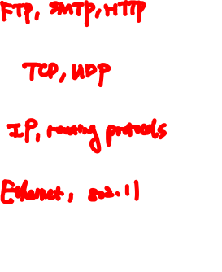
Internet protocol stack
application: supporting network applications
FTP, SMTP, HTTP
transport: process-process data transfer
TCP, UDP
network: routing of datagrams from source to destination
IP, routing protocols
link: data transfer between neighboring network elements
Ethernet, 802.11 (WiFi)
physical: bits “on the wire”
application
transport
network
link
physical

Slide 65
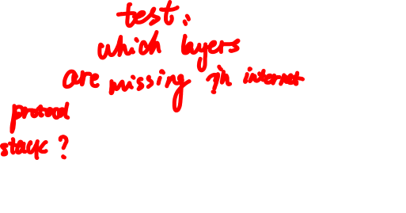
ISO/OSI reference model
presentation: allow applications to interpret meaning of data, e.g., encryption, compression, machine-specific conventions
session: synchronization, checkpointing, recovery of data exchange
Internet stack “missing” these layers!
these services, if needed, must be implemented in application
needed?
application
presentation
session
transport
network
link
physical

Slide 66
Encapsulation
source
message
M
application
transport
network
link
physical
segment/datagram
H_{t}
M
H_{t}
packet
H_{n}
H_{n}
H_{t}
M
frame
H_{l}
H_{n}
H_{t}
M
link
physical
switch
destination
H_{n}
H_{t}
M
network
link
physical
M
application
transport
network
link
physical
H_{l}
H_{n}
H_{t}
M
H_{n}
H_{t}
M
H_{t}
M
H_{n}
H_{t}
M
H_{l}
H_{n}
H_{t}
M
router
Notes:
Protocol data unit
Network layer: packets->network addressing/routing->routed internetworks
Data link layer: frames->media access control->switched internetworks
physical layer: signals, bit streams->physical media

Slide 67
Chapter 1: roadmap
1.1 what is the Internet?
1.2 network edge
end systems, access networks, links
1.3 network core
packet switching, circuit switching, network structure
1.4 delay, loss, throughput in networks
1.5 protocol layers, service models
1.6 networks under attack: security
1.7 history
Notes:
67

Slide 68
Network security
field of network security:
how bad guys can attack computer networks
how we can defend networks against attacks
how to design architectures that are immune to attacks
Internet not originally designed with (much) security in mind
original vision: “a group of mutually trusting users attached to a transparent network” ☺
Internet protocol designers playing “catch-up”
security considerations in all layers!

Slide 69
Bad guys: put malware into hosts via Internet
malware can get in host from:
virus: self-replicating infection by receiving/executing object (e.g., e-mail attachment)
worm: self-replicating infection by passively receiving object that gets itself executed
spyware malware can record keystrokes, web sites visited, upload info to collection site
infected host can be enrolled in botnet, used for spam. DDoS attacks

Slide 70
Bad guys: attack server, network infrastructure
Denial of Service (DoS): attackers make resources (server, bandwidth) unavailable to legitimate traffic by overwhelming resource with bogus traffic
1. select target
2. break into hosts around the network (see botnet)
3. send packets to target from compromised hosts
target

Slide 71
Bad guys can sniff packets
packet “sniffing”:
broadcast media (shared ethernet, wireless)
promiscuous network interface reads/records all packets (e.g., including passwords!) passing by
A
C
src:B dest:A payload
B
wireshark software used for end-of-chapter labs is a (free) packet-sniffer

Slide 72

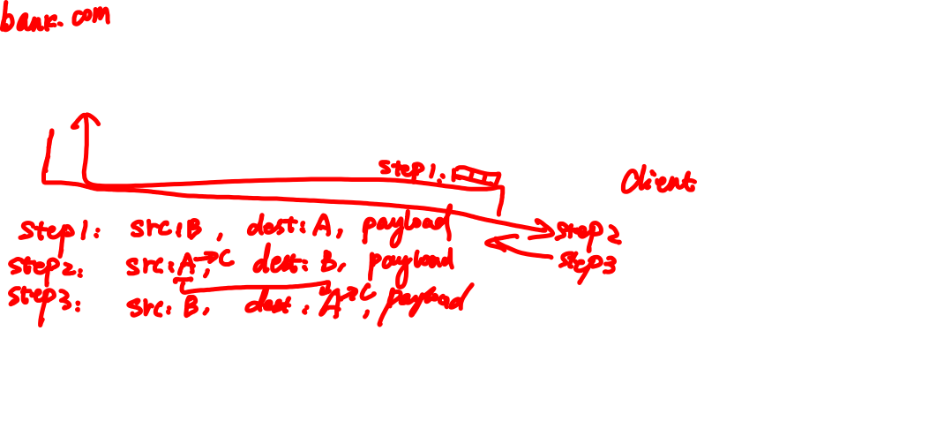
Bad guys can use fake addresses
IP spoofing: send packet with false source address
A
C
src:B dest:A payload
B
… lots more on security (throughout, Chapter 8)

Slide 73
Chapter 1: roadmap
1.1 what is the Internet?
1.2 network edge
end systems, access networks, links
1.3 network core
packet switching, circuit switching, network structure
1.4 delay, loss, throughput in networks
1.5 protocol layers, service models
1.6 networks under attack: security
1.7 history
Notes:
73

Slide 74
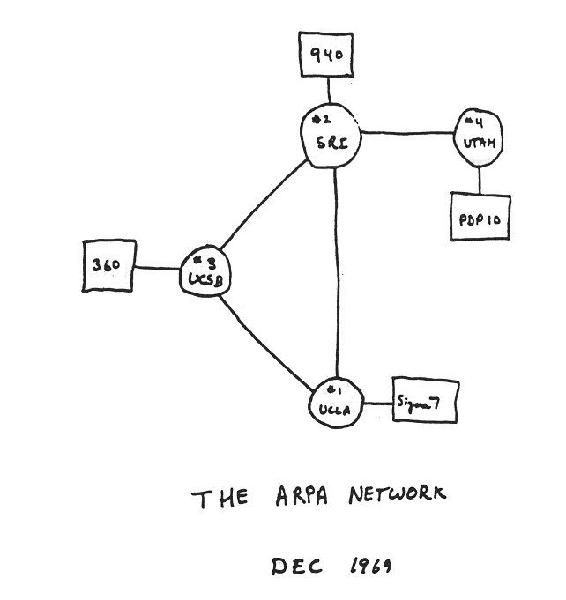
Internet history
1961-1972: Early packet-switching principles
1961: Kleinrock - queueing theory shows effectiveness of packet-switching
1964: Baran - packet-switching in military nets
1967: ARPAnet conceived by Advanced Research Projects Agency
1969: first ARPAnet node operational
1972:
ARPAnet public demo
NCP (Network Control Protocol) first host-host protocol
first e-mail program
ARPAnet has 15 nodes

Slide 75
Internet history
1972-1980: Internetworking, new and proprietary nets
1970: ALOHAnet satellite network in Hawaii
1974: Cerf and Kahn - architecture for interconnecting networks
1976: Ethernet at Xerox PARC
late70’s: proprietary architectures: DECnet, SNA, XNA
late 70’s: switching fixed length packets (ATM precursor)
1979: ARPAnet has 200 nodes
Cerf and Kahn’s internetworking principles:
minimalism, autonomy - no internal changes required to interconnect networks
best effort service model
stateless routers
decentralized control
define today’s Internet architecture

Slide 76
Internet history
1980-1990: new protocols, a proliferation of networks
1983: deployment of TCP/IP
1982: smtp e-mail protocol defined
1983: DNS defined for name-to-IP-address translation
1985: ftp protocol defined
1988: TCP congestion control
new national networks: Csnet, BITnet, NSFnet, Minitel
100,000 hosts connected to confederation of networks

Slide 77
Internet history
1990, 2000’s: commercialization, the Web, new apps
early 1990’s: ARPAnet decommissioned
1991: NSF lifts restrictions on commercial use of NSFnet (decommissioned, 1995)
early 1990s: Web
hypertext [Bush 1945, Nelson 1960’s]
HTML, HTTP: Berners-Lee
1994: Mosaic, later Netscape
late 1990’s: commercialization of the Web
late 1990’s – 2000’s:
more killer apps: instant messaging, P2P file sharing
network security to forefront
est. 50 million host, 100 million+ users
backbone links running at Gbps

Slide 78
Internet history
2005-present
~750 million hosts
Smartphones and tablets
Aggressive deployment of broadband access
Increasing ubiquity of high-speed wireless access
Emergence of online social networks:
Facebook: soon one billion users
Service providers (Google, Microsoft) create their own networks
Bypass Internet, providing “instantaneous” access to search, emai, etc.
E-commerce, universities, enterprises running their services in “cloud” (eg, Amazon EC2)
Notes:
Trends: distributed systems, mobile, cloud, CPS, IoT

Slide 79
Introduction: summary
covered a “ton” of material!
Internet overview
what’s a protocol?
network edge, core, access network
packet-switching versus circuit-switching
Internet structure
performance: loss, delay, throughput
layering, service models
security
history
you now have:
context, overview, “feel” of networking
more depth, detail to follow!

